Slide 1
Section 3.3 Solving Problems and Equations with Polynomial Functions
© Copyright all rights reserved to Homework depot: www.BCMath.ca

Slide 2
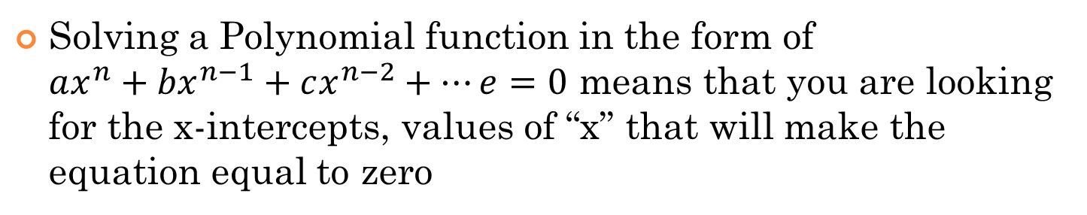
i) Solving A Polynomial Function
Solving a Polynomial function in the form of $ax^{n}+{bx}^{n−1}+cx^{n−2}+…e=0$ means that you are looking for the x-intercepts, values of “x” that will make the equation equal to zero
Step1: Convert the polynomial into the factor form by using the factor theorem
2nd Once it’s factored into brackets, take each bracket and solve for “x”

Slide 3
Practice: Given the following equation, solve for “x”
Factor the polynomial using the factor theorem
Factor the polynomial
Factor the trinomial
Solve for “x” from each bracket
Solve for “x” from each bracket

Slide 4
Ex: Solve for “x”:

Slide 5
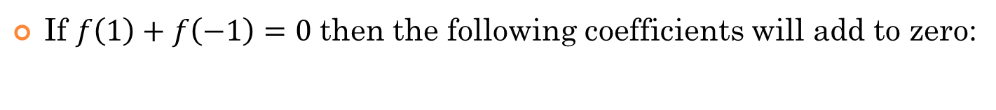
ii) Clues from a Polynomial Function:
Suppose we have a polynomial function in the form of:
The value of “G” (Constant Term) can be found by making x=0
This is the y-intercept
The “sum of the coefficients” can be found by making x=1
If $f\left(1\right)+f\left(−1\right)=0$then the following coefficients will add to zero:

Slide 6
Maximum and Minimum points::
Absolute Max: the point on a function with the greatest y-coordinate
Absolute Min: the point on a function with the smallest y-coordinate
Relative Max: (Local Max) A maximum point on top of a “hill”
Relative Min.: (Local Min) A minimum point on the bottom of a “valley”
If a graph extends up to positive infinity, there will not be any “absolute Max”
If a graph extends down to negative infinity, there will not be any “absolute Min”
D
B
C
A

Slide 7
Ex: Find all the Relative/Absolute Max & Min.
A
A
C
E
C
E
B
D
A
B
D

Slide 8
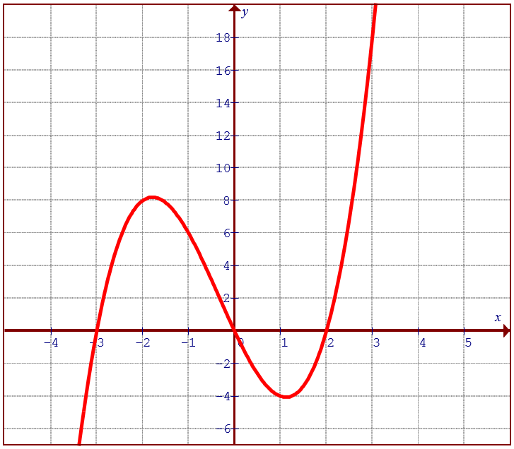
How to Find the Local Max:
One way to approximate the local max is to assume that it appears in the middle between the roots
Plug the x-value into the equation to find the y-value

Slide 9
2nd Method: Find the Derivative of a Polynomial
The derivative of a function provides the slope of a function in terms of “x”
This f(x) gives the y-coordinate for each input value “x”
This f ‘(x) gives the slope of f(x) for each input value “x”
Ex: Find f ‘(x) for each of the functions:

Slide 10
Using Derivates to Find Local Max and Min
Suppose the function below is:
Get the derivative of the function:
f ’(x) gives us the slope at different points of the graph
This tangent line will have a slope of 15
This tangent line will have a slope of 2
Suppose we get to the local Max,
The tangent line will be horizontal and the slope will be ZERO!!

Slide 11
Ex: Given the function, find the coordinates of the local max and local min:
Step 1: Find the derivative
Step 2: Set the derivative equal to zero and solve for “x”
Step 3: Plug “x” values into f(x) to find the y-values

Slide 12
Ex: Given each polynomial function, find the coordinates of the local/relative max/min. State the domain and range.
Local Max: (-1,4.16666)
Local Min: (1,-5.16666)
ABS Min: (-3.5, -12.76)
Domain:
Range:
Local Max: (-2,26)
Local Min: (2,-6)
Domain:
Range:

Slide 13
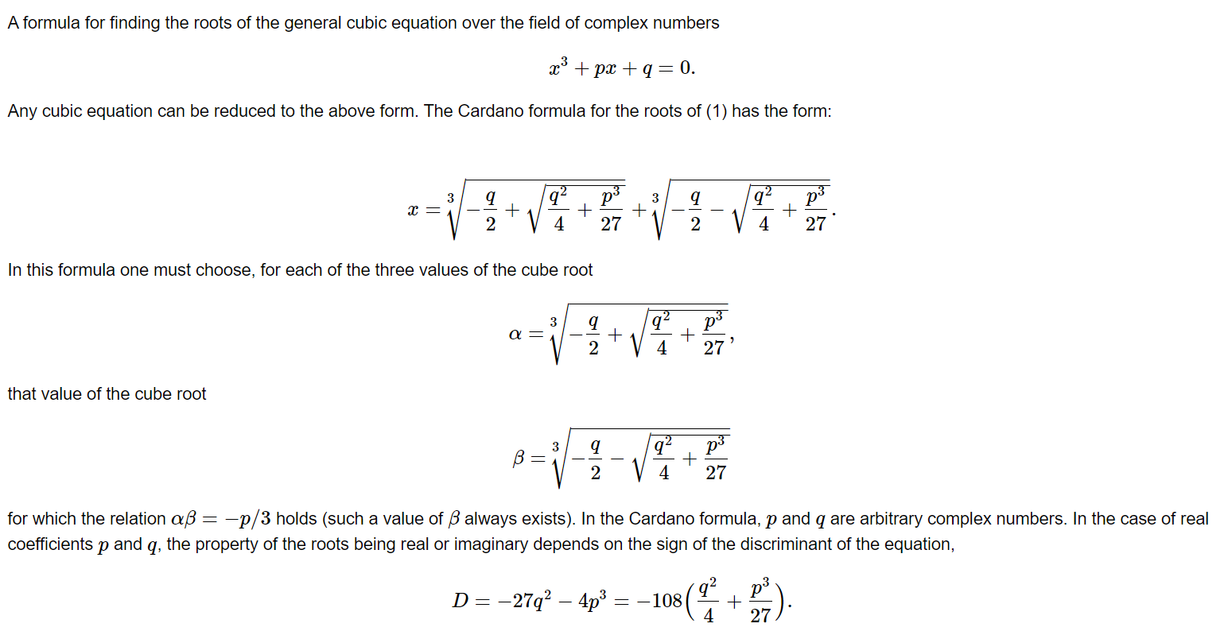

Slide 14
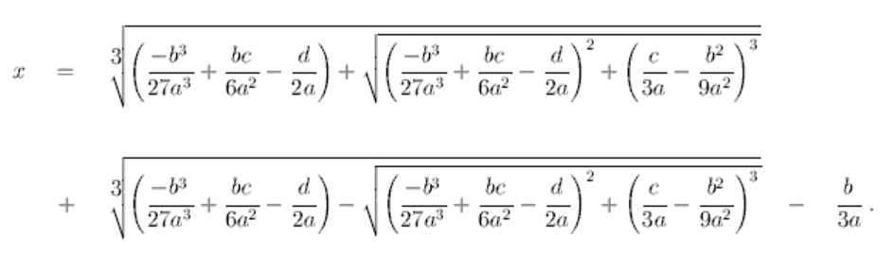
CUBIC Formula:
Cardano in 1545

Slide 16
The Cubic Formula:
The formula for solving a cubic formula is a lengthy 9 step process:
We are now half way through finding the roots, but here are 3 things to remember:
If h > 0 , then there is only 1 real root and the rest are complex
If h < 0 , then there is only all the roots are real root
If h = 0, f=0 and g=0 , then there all 3 roots are equal

Slide 17
There are six more steps left:
You are almost there……

Slide 18
The last steps: (Formula for the roots)

Slide 19
Ex:Solve for”x” (save this for complex numbers:
Multiply both sides by (x-3)
Solutions are complex numbers

Slide 20
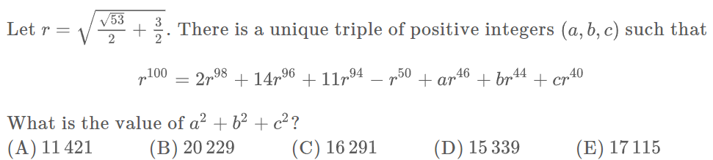
One of the hints that we can use is from the value of “r” that is given:
Now you have a relationship between r⁴ and r² that can be used to simplify your equation
Let’s try and simplify this part first…

Slide 21
Your equation is now simplified to:
Put this altogether, we get:
From this point on, you want to use the equation with r⁴ and simplify every power of r to become a power of 2

